Slide 1


ACT / Southern NSW Region July '24-June '25
Ngunnawal and Ngambri country

Slide 2
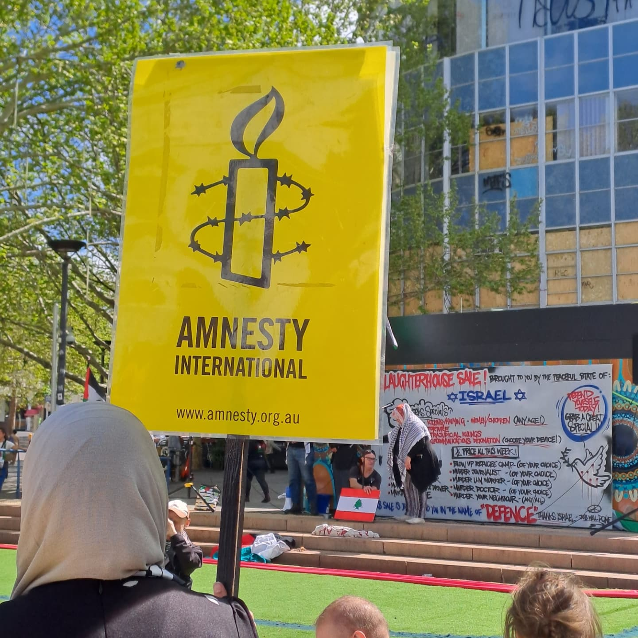
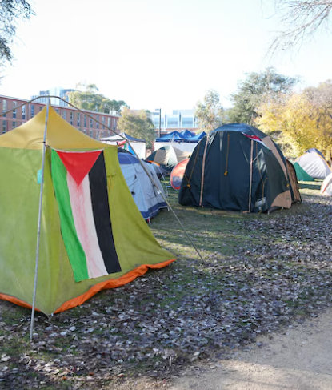
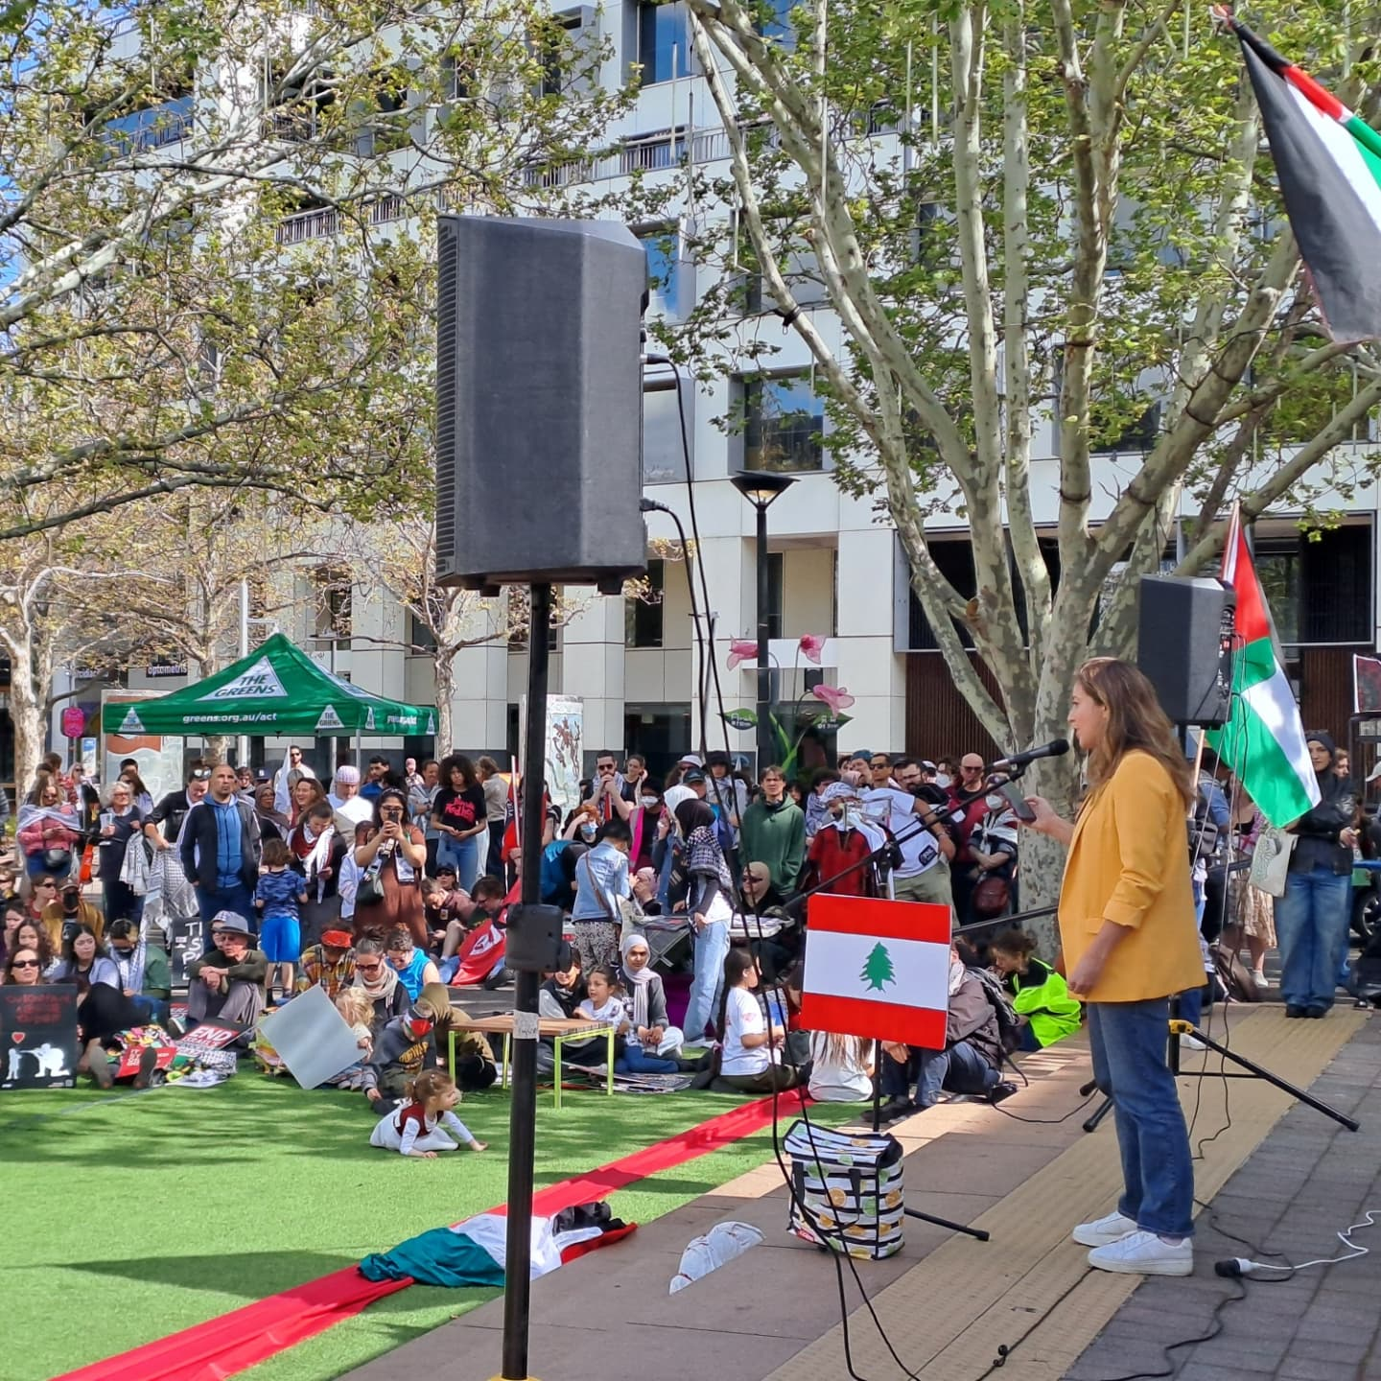
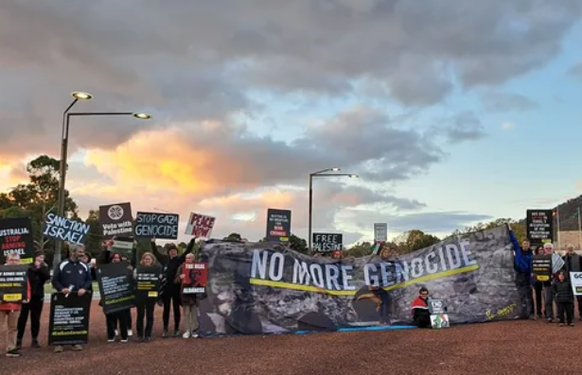
Gaza
Solidarity
Participation in national Gaza group
Support for ANU tent encampment protest rights

Slide 3
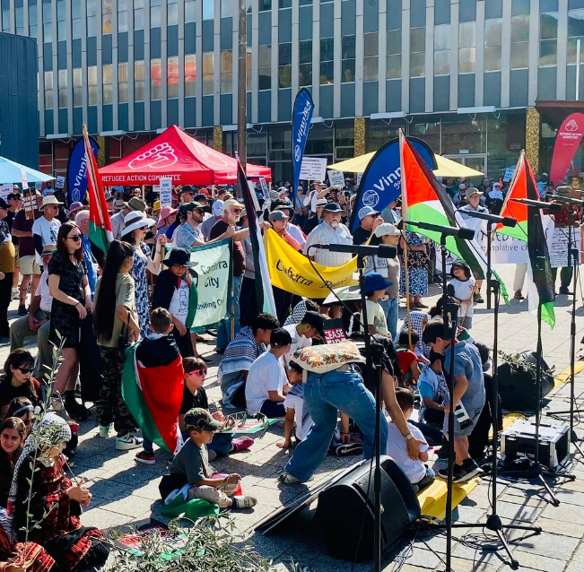
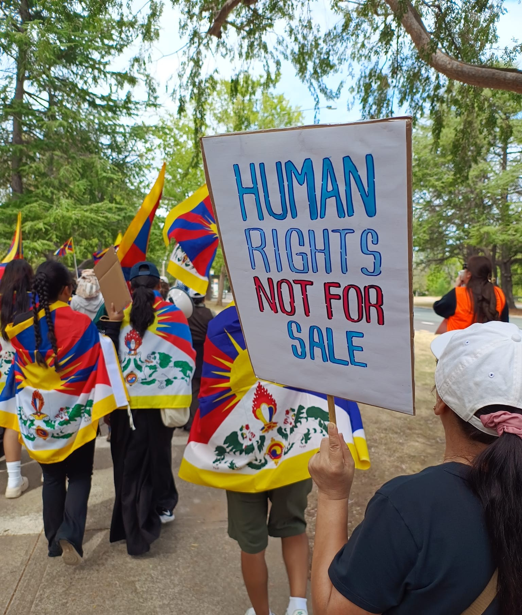
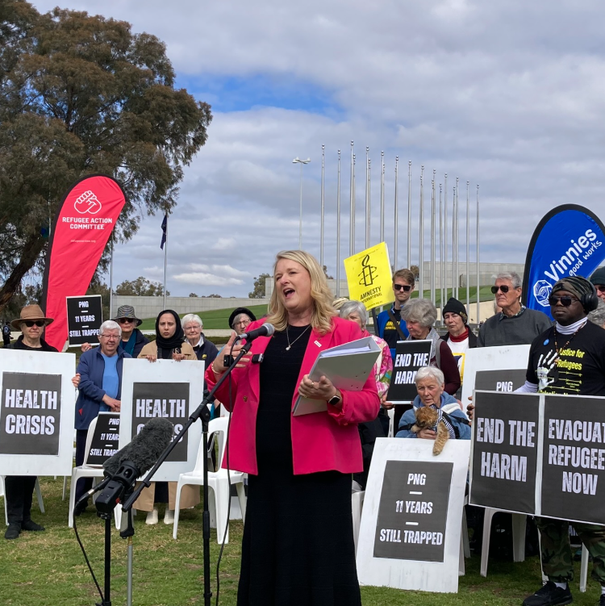
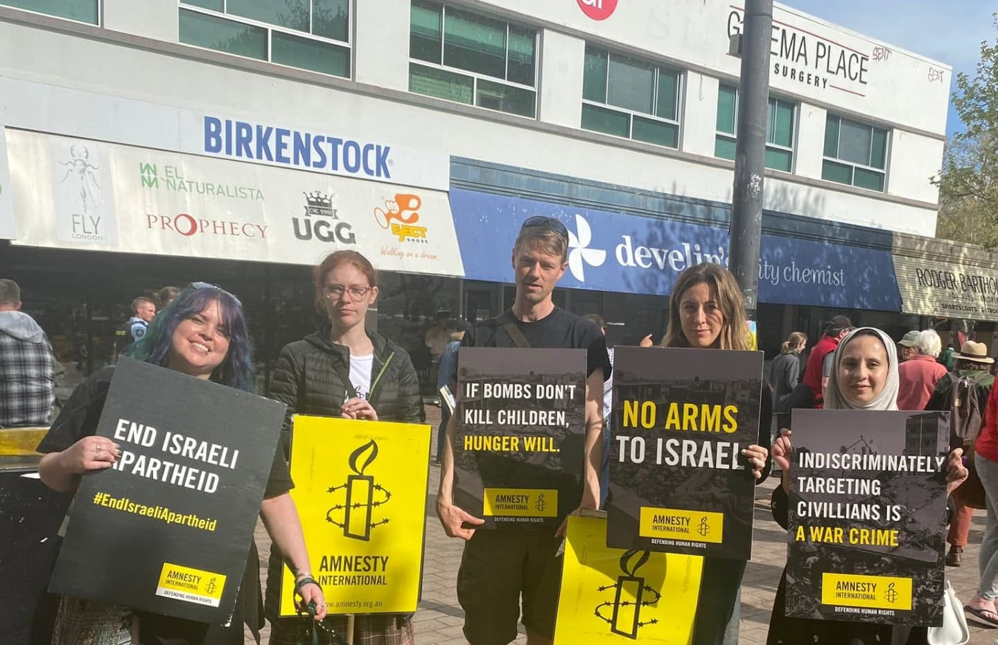
Solidarity
Tibetans – AIA oldest friends
Refugees off Manus
Palm Sunday

Slide 4
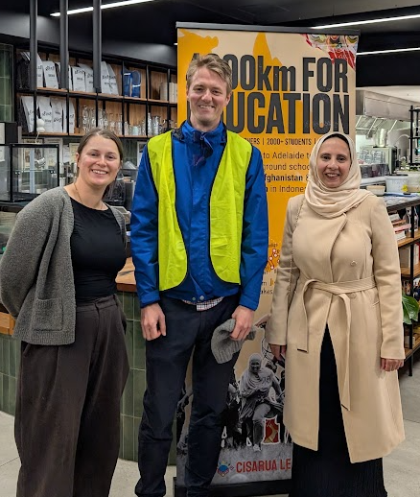
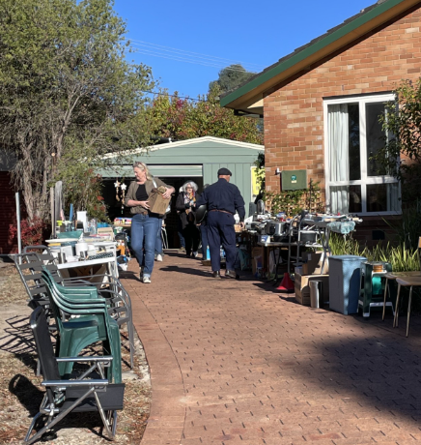
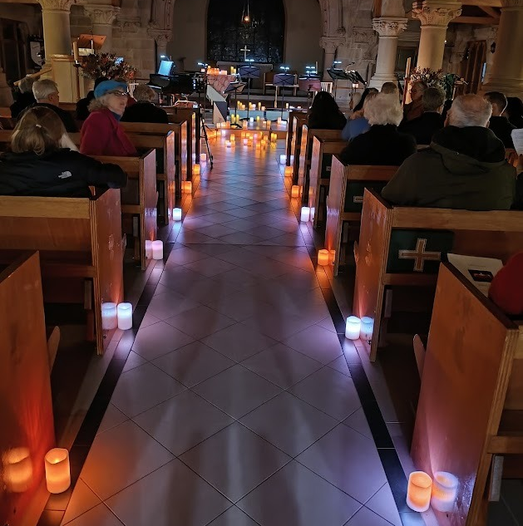

Fundraising support
For AIA and partners
Eklektikka choir in support of Gaza
Muzafar Ali Ride for Education during Refugees Week
Fundraising Group Garage sales in support of AIA - $20k over 13 garage sales.

Slide 5
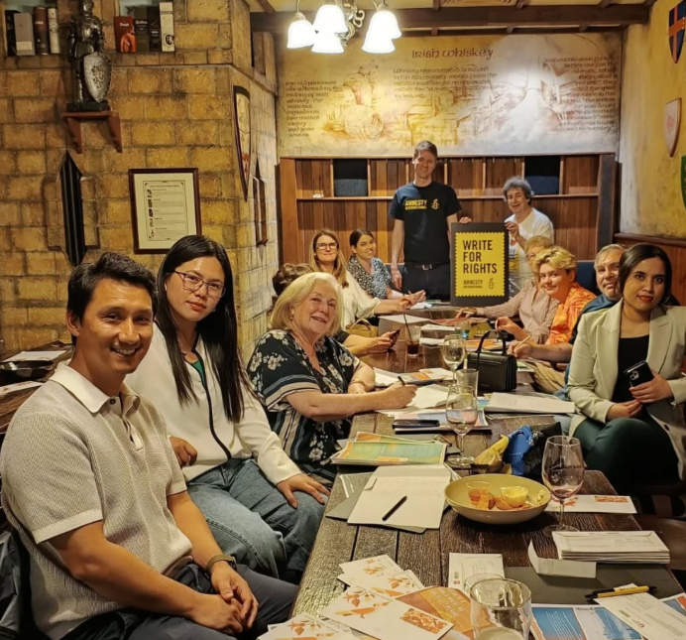
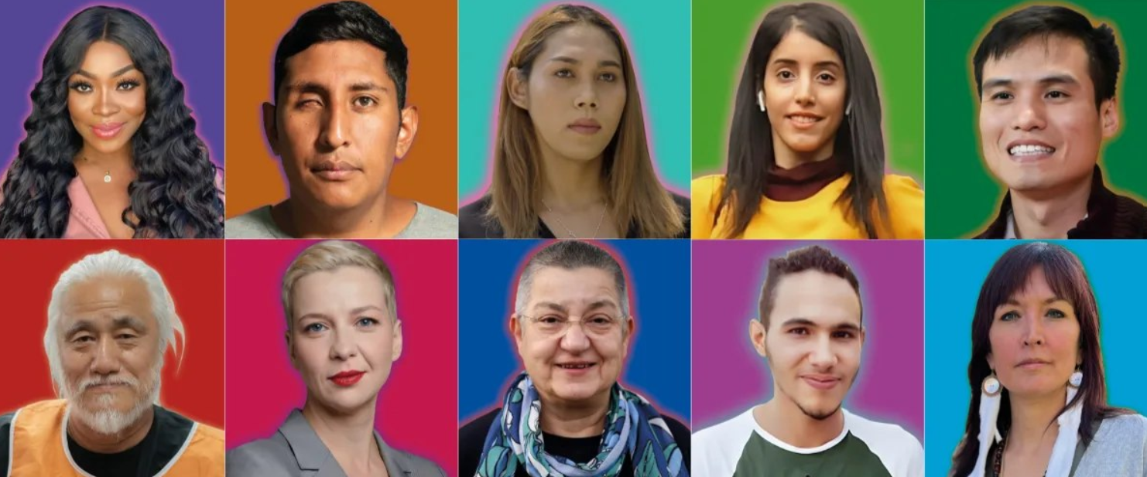
Our biggest Write for Rights
(post-COVID!)

Slide 6

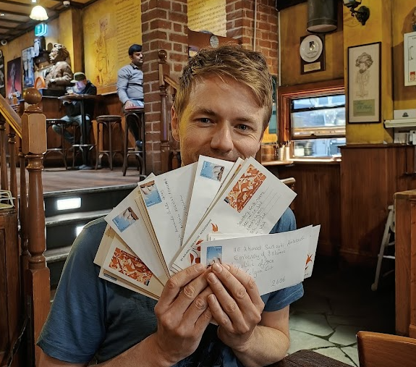
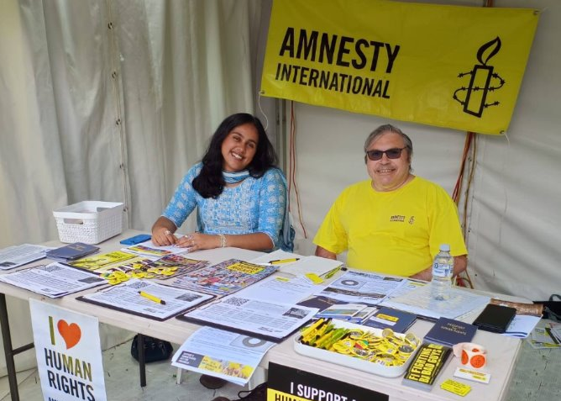
Let's talk!
Appearing in the community digitally and in-person
Contactable supporters
January 144
July: 199

Slide 7
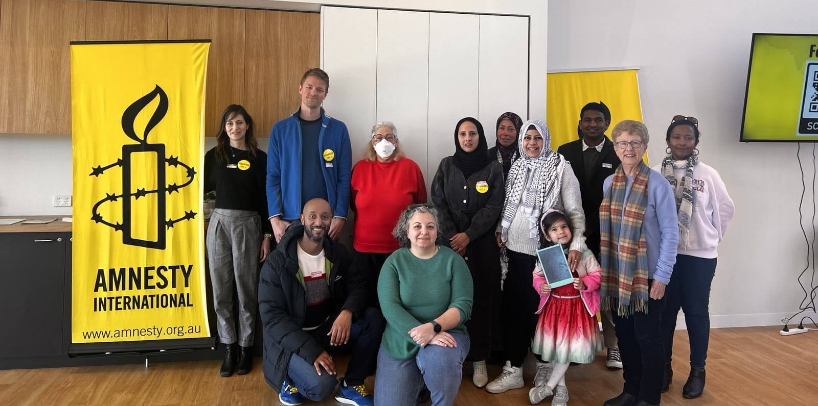
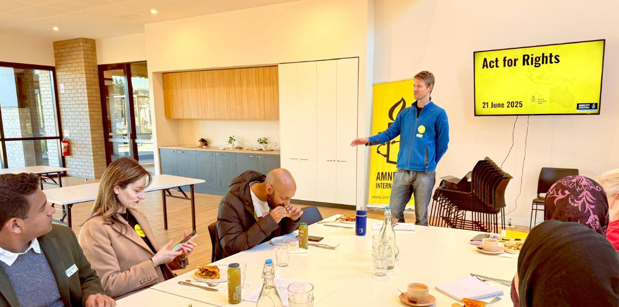
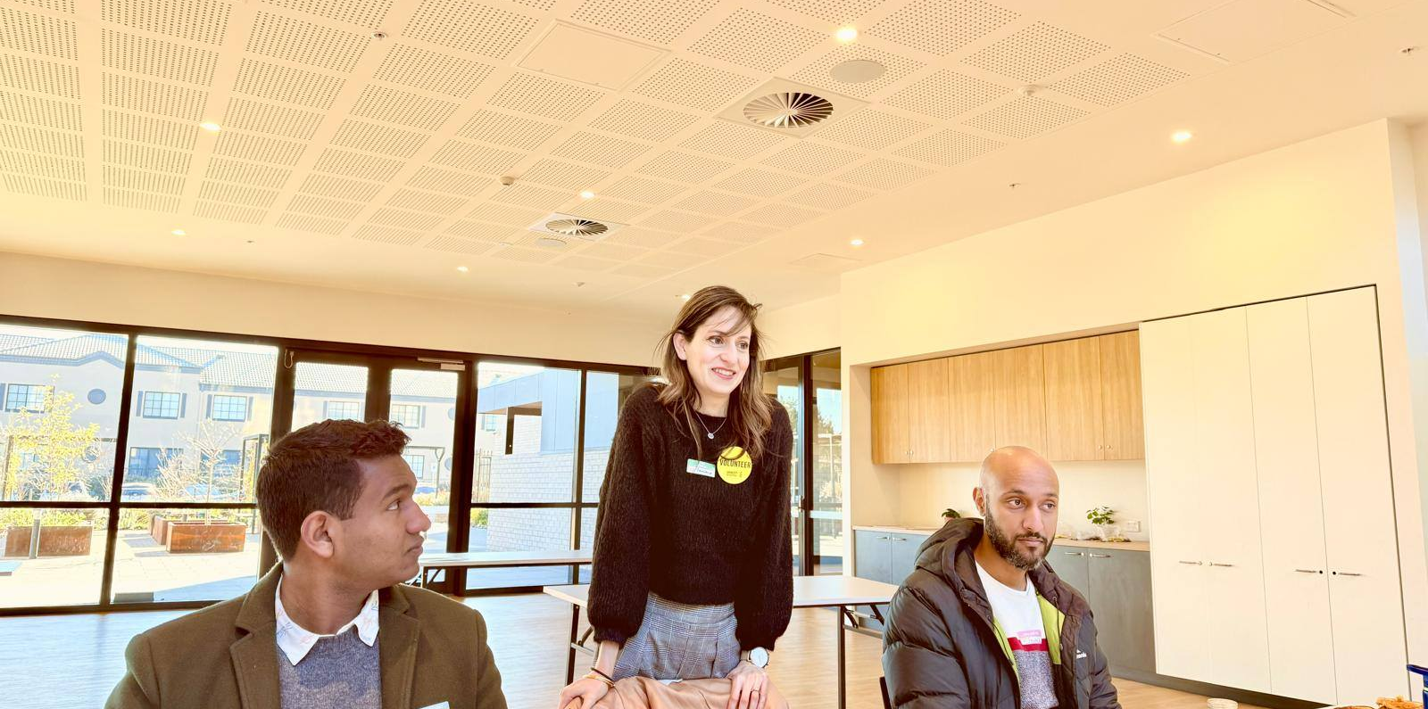
The importance of listening
Supporters and friends discussion:
What do they want from us?
What can we do better?
Who can we work closer with?
..and more questions! But not all the answers – yet.

