Slide 1
2025 Queensland &
Northern New South Wales
Regional Report

Slide 2
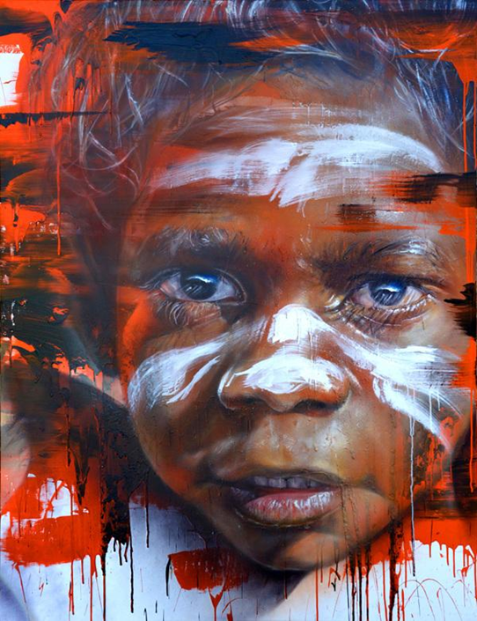
I would like to acknowledge the traditional custodians of the land on which I am today, Jagera and Turrbal people.
I pay my respects to Elders past, present and acknowledge that this land always was and always will Aboriginal land
Artist - Adnate

Slide 3
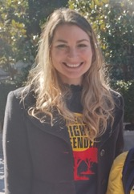
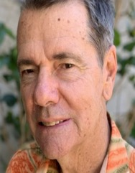
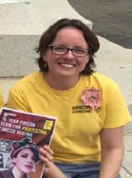
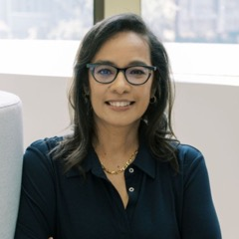
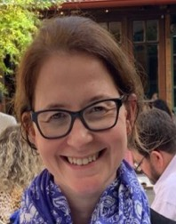
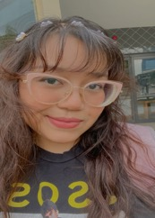
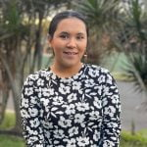
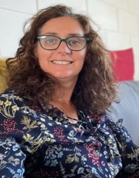
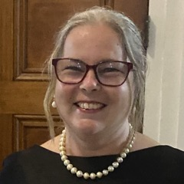
QUEENSLAND NORTHERN NSW ALC
Maddie Wood
Peter Hanley
Ruth Gould
Carol Cooper
Rachel Baggoley
Ili Nazurah Khairul
Fahima Ahmadi
Bronwen Kippen
Paige Garland
Notes:
9 Members

Slide 4
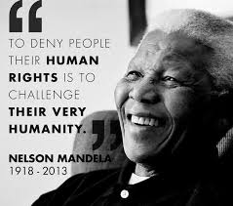
QLD & NNSW – WHERE WE ARE AT:
Over 700 members
Active community groups: Townsville, Chermside, Toowoomba, Ashgrove, Redlands, Gold Coast, and Gold Coast Vision, Youth Justice Network
Emerging groups: Cairns, Capricorn Coast, Meanjin Youth Group
Key Partnerships: UQ Social Change Lab, Queensland Community Alliance
Bi-monthly activist catch-ups
Key event: Annual Brisbane school conference

Slide 5
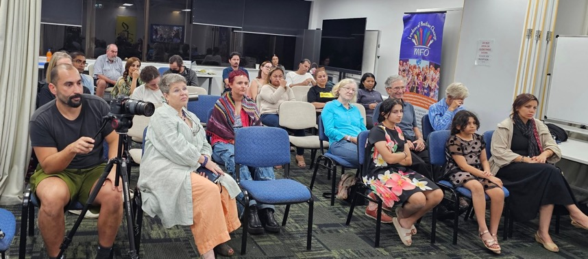
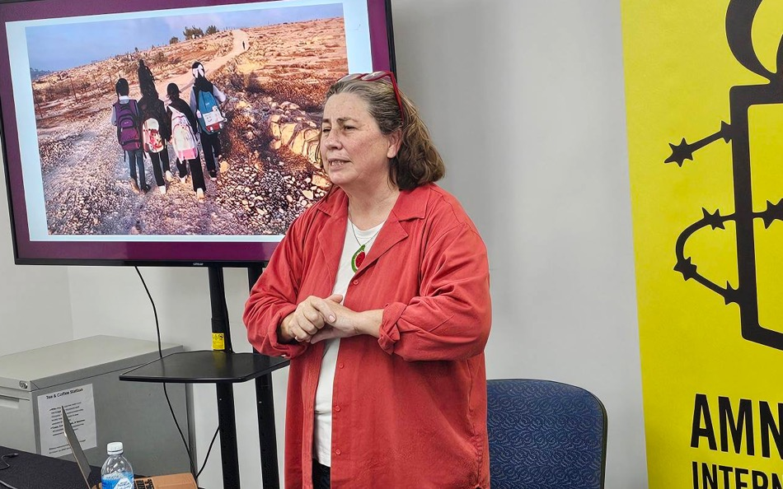
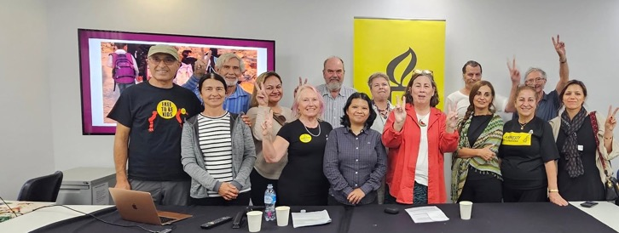
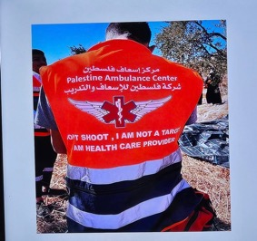
GOLD COAST
Notes:
Gold Coast Group has been doing very active again this year, with stalls, community awareness raising sessions and support local protests about the gaza crisis and First Nations rights. Close connection with the multicultural communities on the Gold Coast.

Slide 6
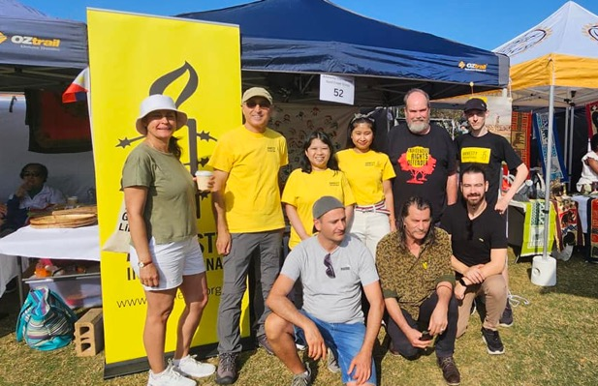
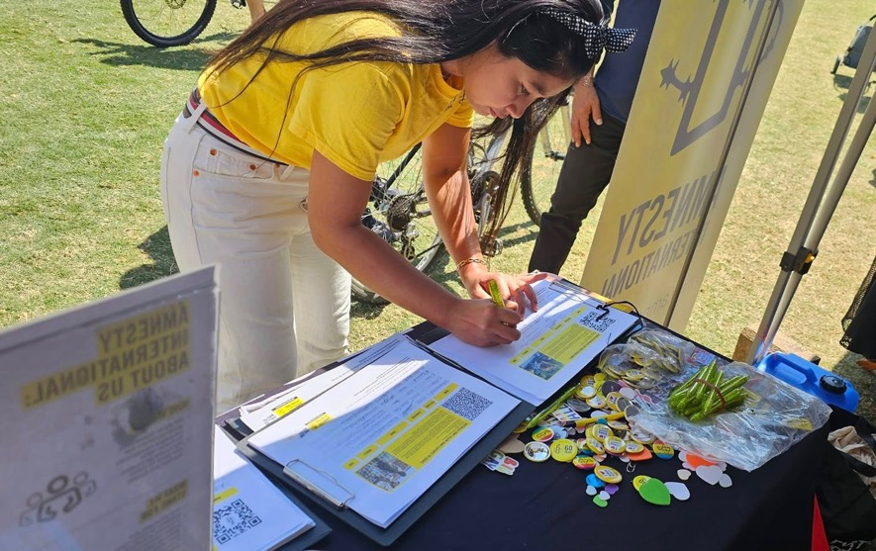
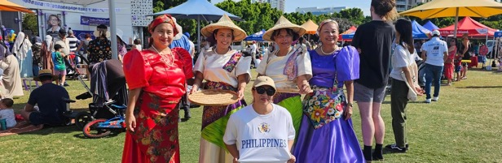
GOLD COAST

Slide 7
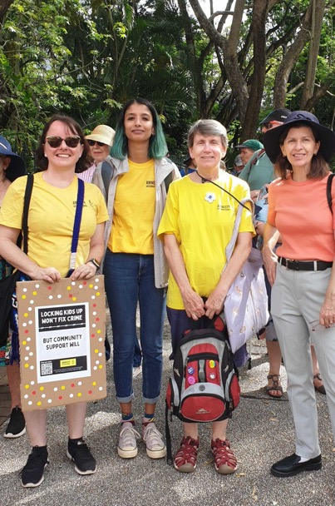
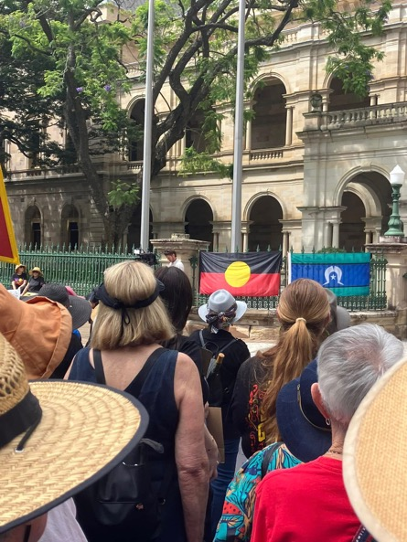
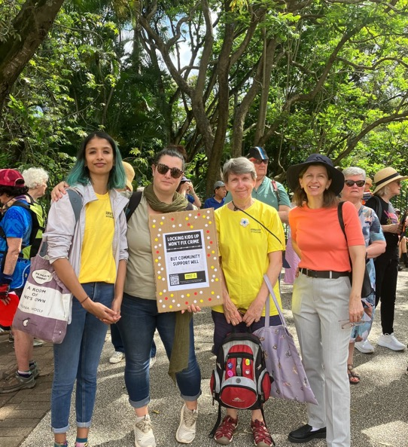
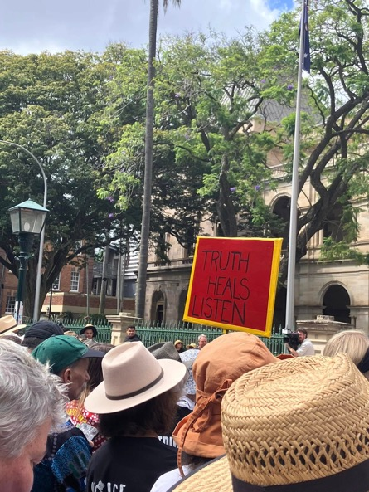
CHERMSIDE
Notes:
- Members of the Chermside Group at Queensland Parliament House protesting against the Make Queensland Safer Laws – Adult Crime Adult Time – Organised by the First Nations Justice Network

Slide 8


TOOWOOMBA
Notes:
This is a collaboration between Inclusive Counselling Collective, Amnesty International, and a committee of local LGBTQIA+ people.

Slide 9
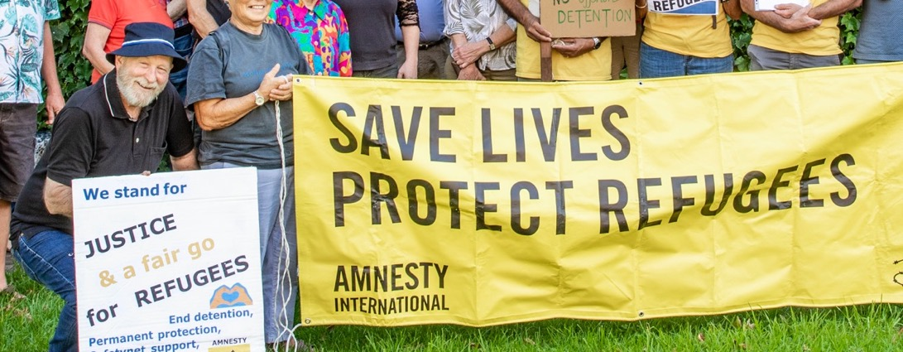
Phil Armit awarded the David George Award for outstanding and meritorious contribution to Amnesty and Human Rights
Notes:
Phil was awarded the QLD NNSW ‘David George’ Award for outstanding and meritorisous contribution to Amnesty and Human Rights. In his region in Toomowba, Phil has led and connected with many community members to foster and support human rights in the community and in local schools. Phil as consistently campaigned for refugee rights fnd first nations rights for many years, and most recent LGBTIQIA rights.

Slide 10
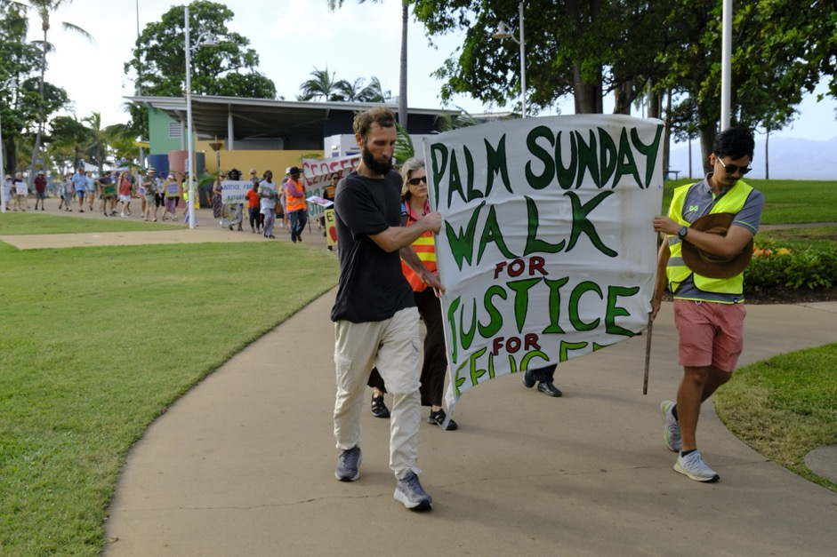
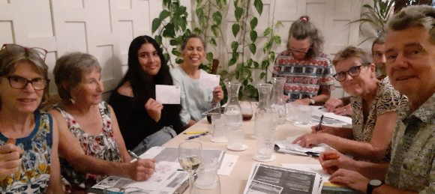
TOWNSVILLE
Notes:
Letter writing event for Write for Rights
150 people joined the 2025 Palm Sunday Walk for Peace and Justice for Refugees sponsored by the Townsville Amnesty Group and Townsville Multicultural Support Group (TMSG).

Slide 11
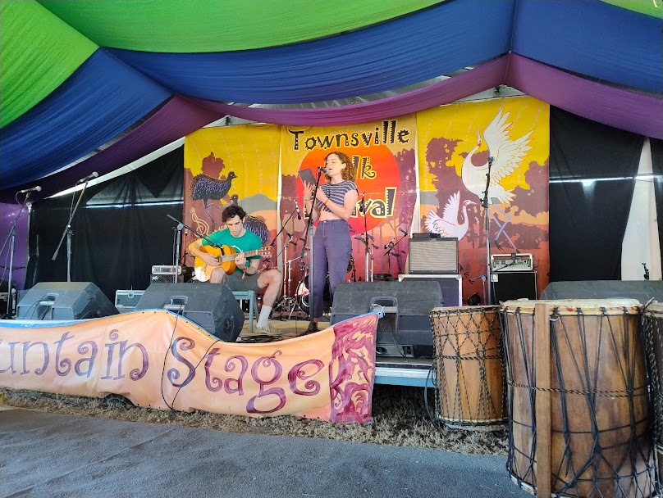
TOWNSVILLE
Notes:
Emily Webster and Jared Johnston - winners of the Amnesty International Human Rights Songwriting Competition at the 2025 Townsville Folk Festival

Slide 12
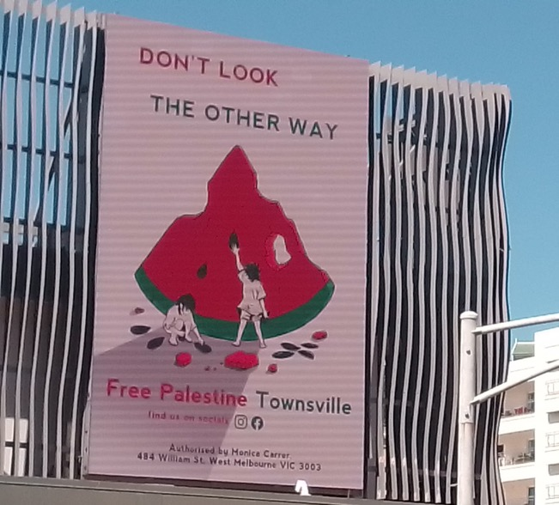
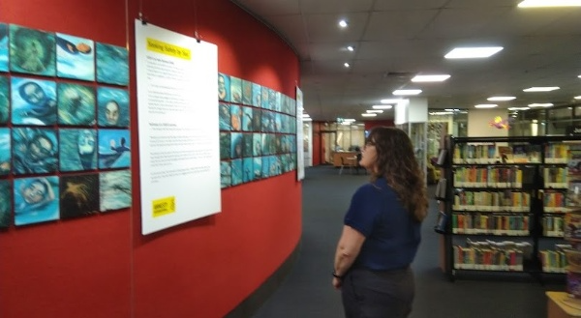
TOWNSVILLE
Notes:
SIEV-X photo exhibition in the Townsvile Library
Our group contributed to the Free Palestine Townsville electronic billboard project

Slide 13


GOLD COAST VISION GROUP
Write for rights human rights and community art project 2025-26
Notes:
Gold Coast Vision Group this year have been focused on a supporting a long-term community arts activity across they year that will result in art and advocacy event for the 2025 Write for rights campaign.

Slide 14
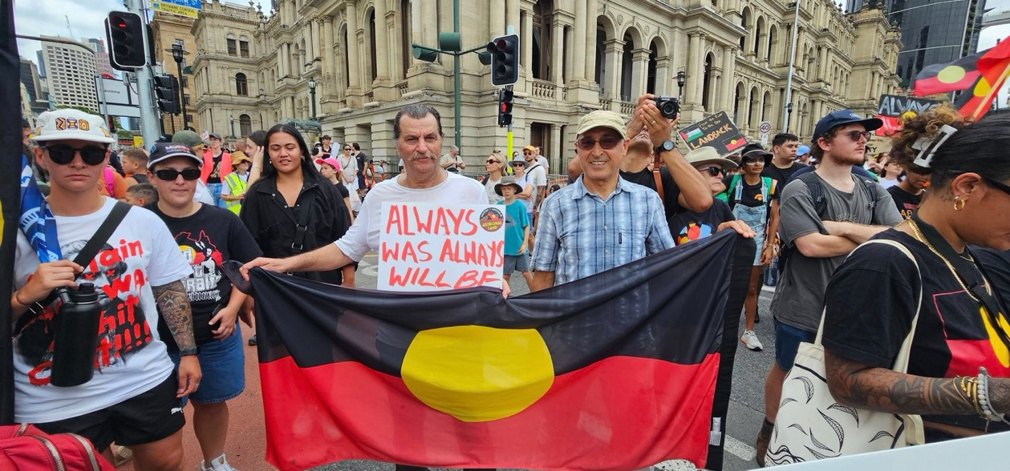
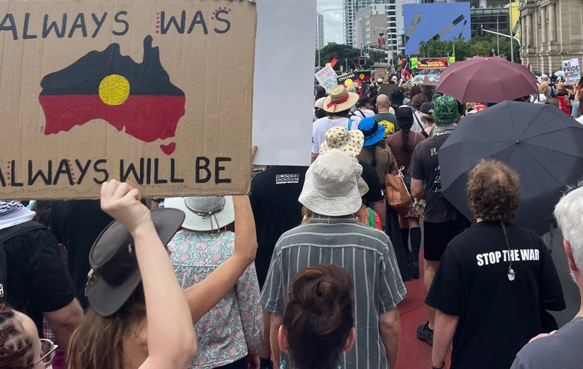
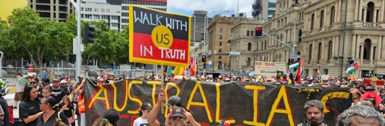
BRISBANE, GOLD COAST, CHERMSIDE

Slide 15
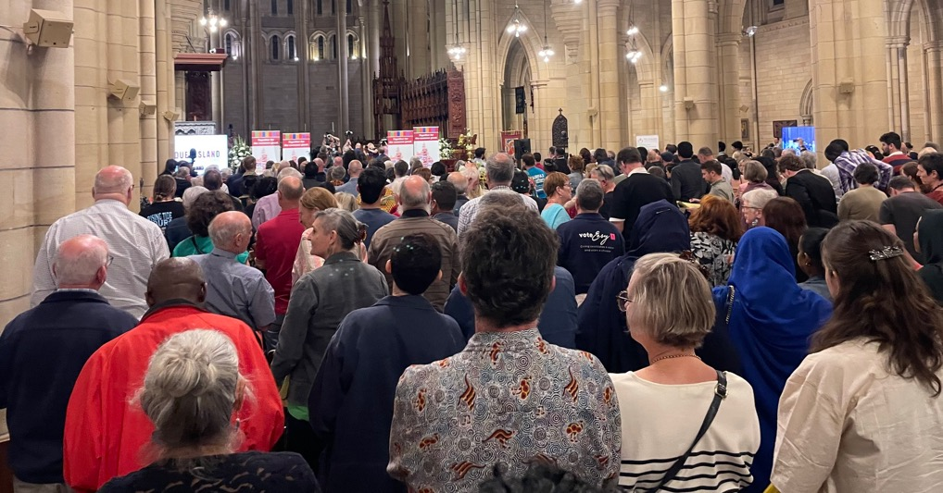
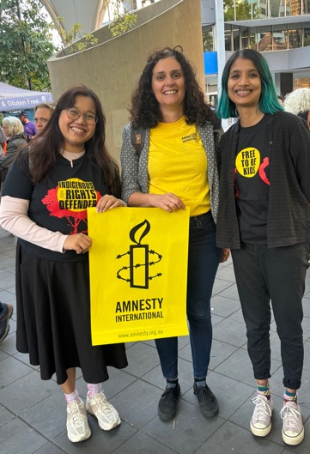
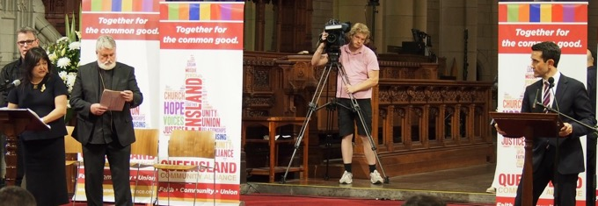
QUEENSLAND STATE ELECTION LEADERS FORUM QUEENSLAND COMMUNITY ALLIANCE
Notes:
QCA Queensland Election Leaders Forum where part of the the agreed QCA state election platform, we support key element of the platform relation to First nations justice and financial support for refugees. These are photos Brisbane photos, but we also had a group join from Townsville and Elders join from the Torres Strait.

Slide 16
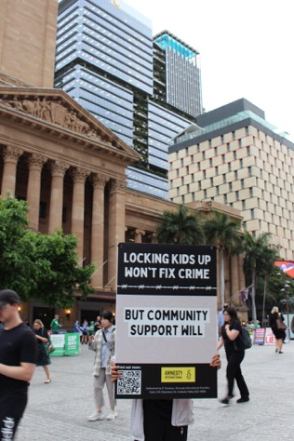
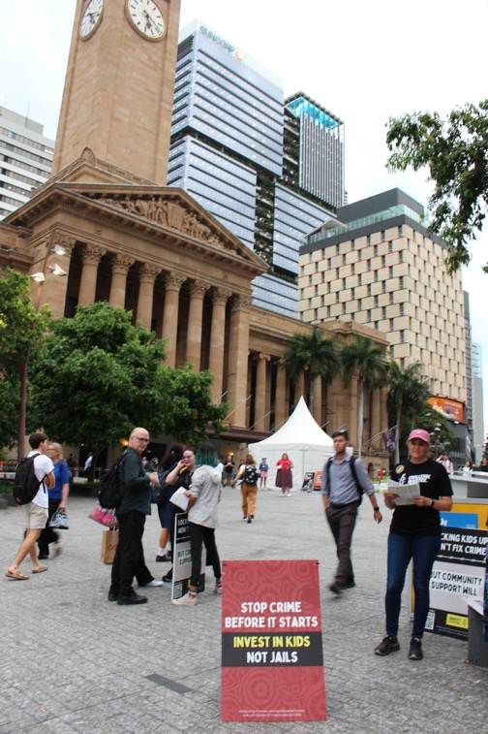
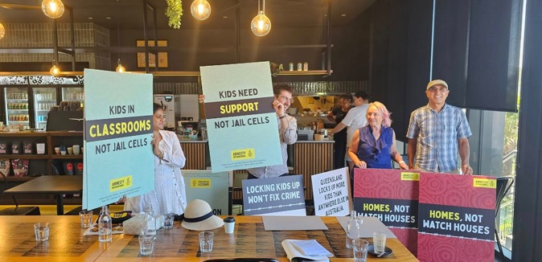
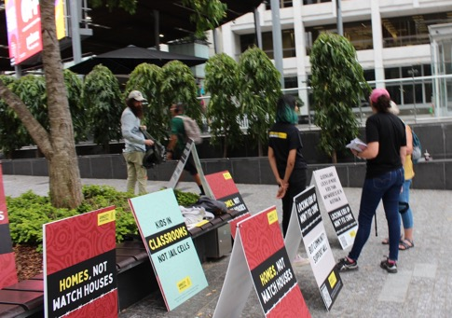
YOUTH JUSTICE NETWORK QUEENSLAND STATE ELECTION
Notes:
Submission writing, promoted online petition, letter dropping, wobble boarding, election booth advocacy. You justices. Rise the age. Investment in family support and therapeutic support not justice system.
vvv Regular updates about research and advocacy occurring across the state in relation to youth justice
Engaged in the Queensland election advocacy (promoted Regular updates about research and advocacy occurring across the state in relation to youth justice
Engaged in the Queensland election advocacy (promoted Regular updates about research and advocacy occurring across the state in relation to youth justice
Engaged in the Queensland election advocacy (promoted

Slide 17
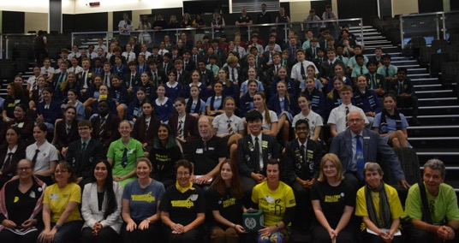
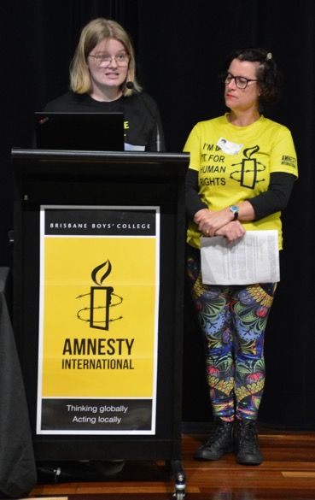
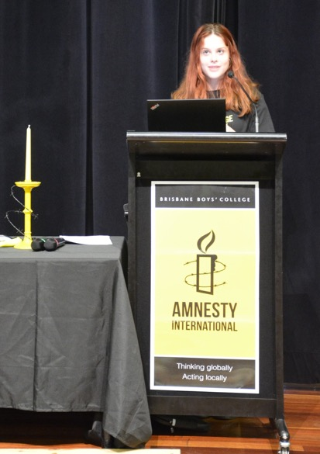
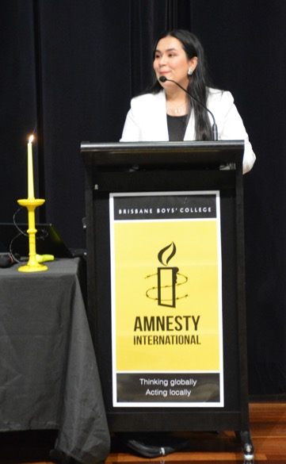
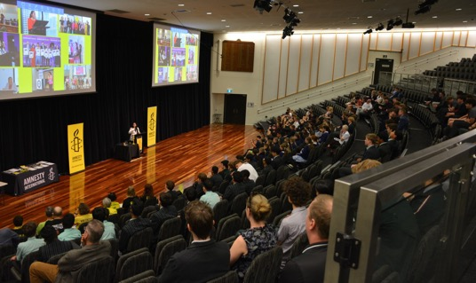
SCHOOL CONFERENCE
Notes:
Refugee rights conference focus on lived experience and allyship.

Slide 18

The year ahead
Regional activists face to face
Connecting and support emerging groups
Connecting with young people
Strengthening partnerships with allies and community groups

Slide 19
A HUGE THANK YOU TO ALL OUR AWESOME ACTIVISTS

